Slide 1
Assessing Economic Vulnerability with Trade Dependency
Notes:
Introduction and Data: Patrick (1.5 min)
Question 1. Elva (1 min)
Question 2. Emma (1 min)
Question 3. Sai (2 min)
Implications and Limitations: Vanessa (2 min)
Web scraping and conclusion: Shardul (2 min)
Good evening everyone, my name is Patrick. Today we’d like to present to the European trade union our findings regarding trade dependencies and economic vulnerability of the key EU. I’d like to introduce my team of analysts, Ema, Elva, Sai, Shardul and Vanessa.

Slide 2
Objectives
Analyse trade dependencies across regions and countries
Identify import and export dependencies
Examine areas of economic vulnerability
Notes:
We’d be focusing on analysing the trade dependencies across regions, an within the most trade dependent region, identifying the most trade dependent countries, and examining the areas of economic vulnerability in these countries.

Slide 3
Data sourcing, auditing and wrangling
GDP (2020)
World Bank Open Data
Removed irrelevant columns
Standardise units
Assign country codes
Wrangle Population
Trade Data (2005-2023)
UN Comtrade
Removed irrelevant columns
Standardise import & export
Pivot into wide format
Wrangle ‘Total Trade’ and ‘Trade Balance’
Assign country codes
Trade Categories (2005-2023)
World Integrated Trade Solution
Select top 3 countries from Question 1
Extract trade categories and import/export values
Country_Code
Country
Country
Country
Country_Code
Country_Code
Country_Code
Region
Year
Product Category
Population
Export Value ($USD)
Export Value ($USD)
GDP ($USD)
Import Value ($USD)
Import Value ($USD)
GDP per capita ($USD)
Total Trade ($USD)
Trade Balance ($USD)
Notes:
We’ve used 3 datasets for our analysis.
The first dataset is the GDP data which was extracted from the world bank open data.
The second dataset is the trade data from UN comtrade, which includes data like export and import values, and based on that we were able to calculate the total trade, trade balance of each country.
The third dataset was from world integrated trade solution, which includes the specific product categories of what has been trade in the country. We’ve audited and merged these datasets together using the country code, for further analysis.
Now I’ll hand it over to Elva to talk about our first theme.

Slide 4
Which Region and Countries are the
Most Trade Dependent?

Slide 5
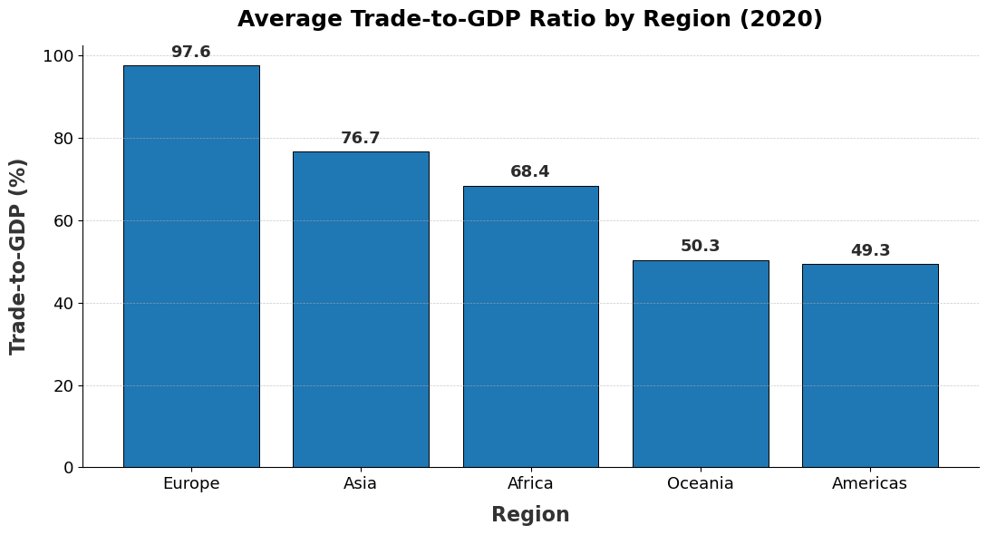
Which region is the most trade-dependent?
Approach
Trade Dependency = (Import+Export)
GDP
Aggregate by Region
Sort by Trade-to-GDP
Key Insights
Europe is the most trade-dependent region
Other regions show lower reliance on international trade
Notes:
The regional comparison shows a very clear pattern: Europe is the most trade-dependent region globally, with trade flows nearly matching its entire GDP.
This indicates a high level of integration into global supply chains, where production and demand rely strongly on cross-border activities.

Slide 6
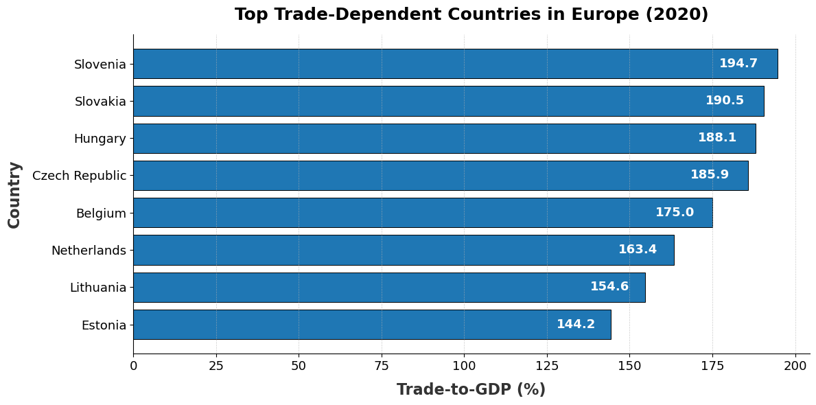
Within Europe, which countries have the highest trade dependency?
Approach
Trade Dependency = (Imports + Exports)
GDP
Filtered by Region (Europe)
Key Insights
Slovenia, Slovakia & Hungary display the highest level of dependence on international trade.
194.7
190.5
188.1
Notes:
When we zoom into Europe, three economies stand out: Slovenia, Slovakia, and Hungary.
Each trades close to 190% of their GDP, meaning they trade almost twice the value of what they produce.
This reflects a structural dependence on international markets and tightly connected manufacturing networks
Overall, the analysis shows that Europe—and especially these three economies—face both the benefits and the risks of high openness, making them more sensitive to global economic conditions.

Slide 7
Import Dependency vs Export Dependency
of the most trade dependent countries in Europe

Slide 8
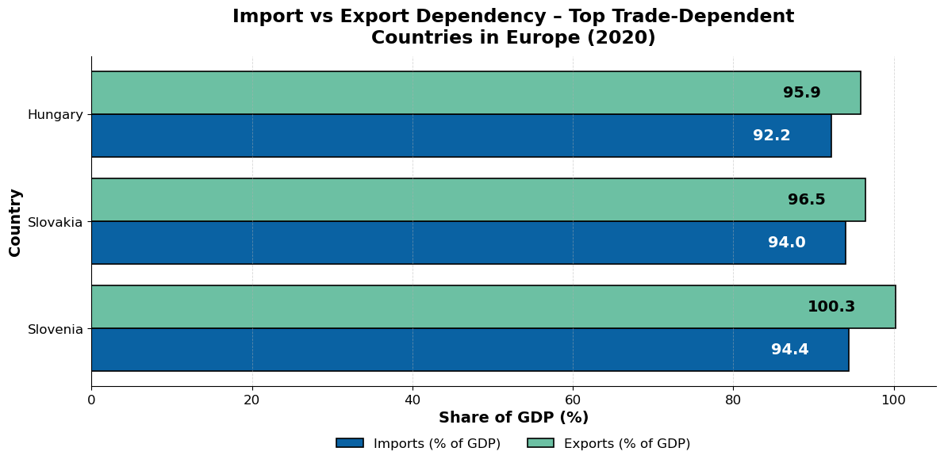
Import Dependency vs Export Dependency
Approach
Calculate Import-to-GDP & Export-to-GDP
Filter by Country - Slovenia, Slovakia, and Hungary
Key Insights
Export > Import
Slovenia with the biggest difference (5.9%)
Notes:
Script:
computing the Export to GDP and Import to GDP to further highlight whether they import more or export more
Based on the chart, all three countries has higher exports than imports (colored in Teal)
Slovenia has largest difference between imports and exports (100.3 export 94.4 import - approx 6% difference, while others are around 3 or less)
Though overall they all present relatively balanced between imports and exports
To look into this further, we will be looking into the types of goods that contributes to imports and exports. Sai will run this through in more detail

Slide 9
Which product categories drive
the top trade dependent countries?
Notes:
script : After finding that Slovenia, Slovakia, and Hungary are the most trade-dependent nations in Europe, we needed to know: What exactly are they trading? What products drive their economy? knowing the total trade value is not enough. We need to see the breakdown of goods to find their strengths and weaknesses. This helps policymakers protect their industries during global problems, like a pandemic or war.
We took each country’s total trade and split it into four simple categories: Raw Materials, Intermediate Goods (parts), Capital Goods (machinery), and Consumer Goods (like finished electronics or clothes). This bar chart shows the final result."

Slide 10
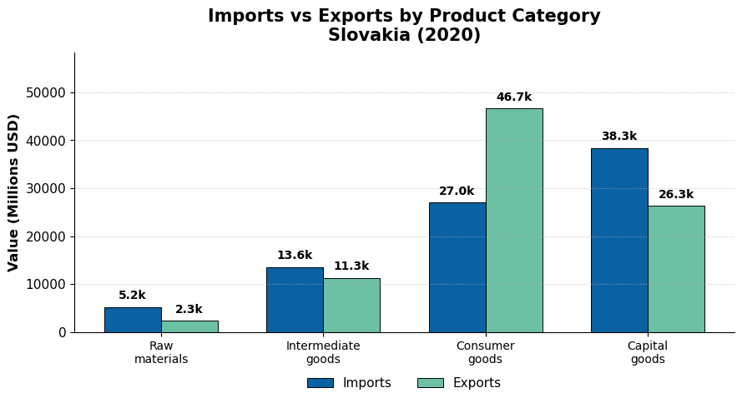
Products Behind Trade Dependence Countries in Europe
Key Insights
Import:
Capital Goods Intermediate Goods
Export:
Consumer Goods
Notes:
Scripts:slovakia: The Assembly Hub.
Slovakia imports the most Capital Goods and Intermediate Goods. This means they buy a lot of machinery and parts from outside.
Why? Because they are a huge manufacturing hub. They use all those imported parts to make finished Consumer Goods, which make up the largest share of their exports.They are dependent on imports for production, but they generate massive wealth through exports.

Slide 11
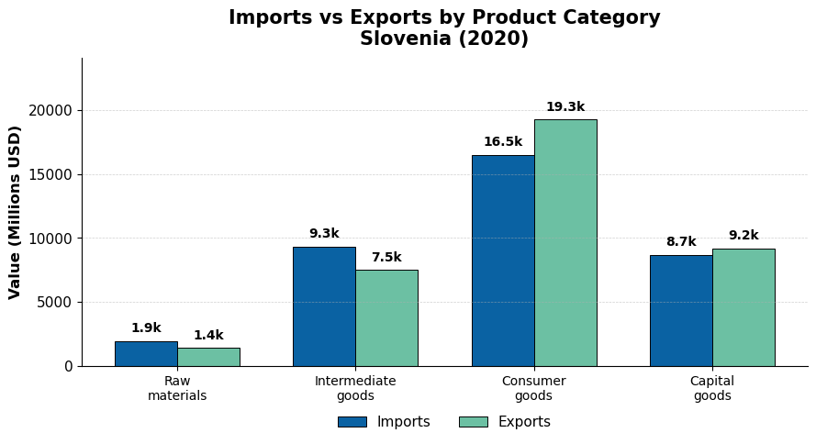
Products Behind Trade Dependence Countries in Europe
Key Insights
Import:
Raw Materials Intermediate Goods
Export:
Consumer Goods
Capital Goods
Notes:
Slovenia: The Balanced Producer.
Slovenia is a net exporter of finished goods. They successfully sell more Consumer Goods and Capital Goods than they buy.
But, just like Slovakia, they have a heavy reliance on imported Raw Materials and Intermediate Goods. They bring in basic materials to create high-value products. It’s a very common 'value-added' model.

Slide 12
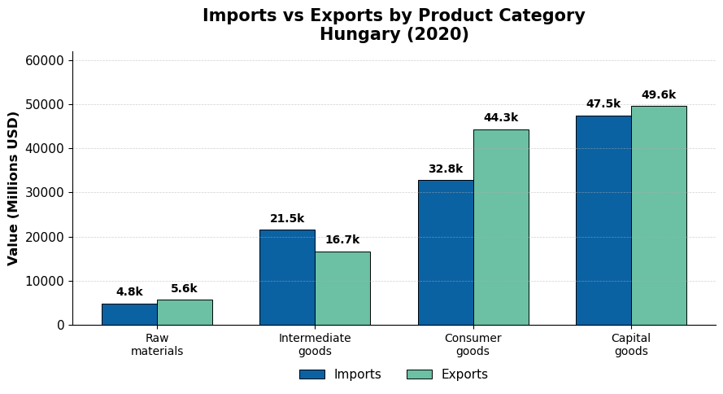
Products Behind Trade Dependence Countries in Europe
Key Insights
Primary product: Capital Goods
Import:
Intermediate goods
Export:
Consumer goods
Notes:
Hungary: The Capital Goods Player.
Hungary's trade is highly focused on Capital Goods—both in imports and exports. This shows they are deeply integrated into Europe's complex manufacturing and supply chains.
Crucially, the data shows their imports of Intermediate Goods are higher than their exports. This tells us that Hungary relies on imported inputs to keep its production lines running.

Slide 13
Implications

Slide 14
IMPLICATIONS FOR DECISION MAKERS
Higher trade dependence = Higher risk of economic vulnerability
Most economically vulnerable region:
Europe - Slovakia, Slovenia and Hungary
Source of economic vulnerability:
Export of Consumer Goods
Diversification
Recent debate: does higher trade dependence increases or decreases the risk of economic vulnerability?
Notes:
In the economic literature, higher trade dependence is often associated with greater economic vulnerability due to the increased exposure to global disruptions.
In today’s increasingly unstable global environment, understanding the sources and areas of regional and national economic vulnerability has become more critical than ever.
Our findings shows Europe to be the most economically vulnerable region in the world, with Hungary, Slovenia, and Slovakia being the most vulnerable countries within the region.
For these three countries, the export sector is the primary area where risk of economic vulnerability lies.
A deeper analysis of their industry categories reveals that Hungary being the least vulnerable among the three, owing to its more diversified export and import industry structure.
Therefore, European Trade Union should explore ways to diversify the industries involved in international trade activities at the national and regional levels.
A recent debate has emerged after the pandemic on over whether higher trade dependence increases or decreases the risk of economic vulnerability, in which our research is not able to answer due to the limitation of our current dataset.

Slide 15
Limitations

Slide 16
Limitation
Future Study with Web Scraping
GDP dataset only include only data of 2020
Unable to study patterns and make predictions.
Trade Dataset lacks information about origin and destination of trade flows
Unable to explore countries’ supply chain vulnerability.
Investigate the trend of trade dependency and effects of the pandemic.
Investigate global supply chain disruptions impact on trade dependency.
Provide insights into economic resilience strategies.
Notes:
While our analysis provides valuable insights, we faced two key limitations. First, our GDP dataset currently contains only one year of data—specifically, 2020. Being the year most affected by the Covid-19 pandemic, this might not be indicative of the true trade and GDP figures. This prevents us from being able to studying historical patterns or making robust future predictions.
Second, the import and export data lacks information on the origin and destination of trade flows. Without this, we cannot fully map or explore a country’s supply chain vulnerability.
In our next study, we will look into data retrical with web scappring
Investigate the trend of trade dependency across multiple years.
Analyze the impact of global supply chain disruptions.
Provide deeper insights into effective economic resilience strategies.

Slide 17
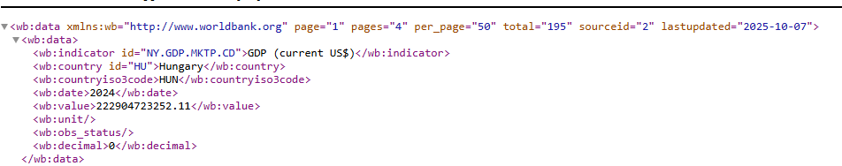
Web scraping Plan
Step 1: Data Retrieval
Scraped GDP time-series data (2005–2023) from the World Bank API, aligned with the time frame of the International Trade dataset. Saved the data as a structured DataFrame for analysis.
The “Requests” and “Response” method using the API for WDI indicators.
Declare the parameters, indicator and countries
Base api url Json
Datapoints extracted
Country
Country
Country_Code
Country_Code
Year
Year
Step 2: Data transformation and merging
The GDP data needs to be transformed into the Billions ($USD)
Matching with the values based on the Iso3 Country code and year
Export Value ($USD)
Import Value ($USD)
Total Trade ($USD)
Trade Balance ($USD)
Notes:
To enrich our study, our future plan focuses on Web Scraping and API retrieval. We will use Python’s requests library to fetch comprehensive GDP time-series data from the World Bank API . This expanded dataset will allow us to:

Slide 18
Conclusion
Europe’s high trade dependency and breakdown by Slovenia, Slovakia, Hungary
Provides a basis for analysis in future studies to realise economic vulnerability and foster sustainable economic growth
Notes:
This project highlights Europe’s significant trading patters, with Slovenia, Slovakia, and Hungary as the most trade-dependent countries within Europe. (in some cases close to 200% of the countries GDP)
Insights into the trade dependencies of these nations are illustrated by analyzing import and export values across key goods categories.
Although limitations in available data prevented a detailed assessment on trade over time, the approach outlined provides a foundation for future research using time-series datasets. These findings can support European trade policymakers in crafting strategies that enhance trade resilience, identifying key areas of economic vulnerability and foster sustainable economic growth.

Slide 19
References

Slide 20
Reference List
Hristanova, J. (2025). The European Union's Trade Policy Amid Rising Global Protectionism. European Generation. https://www.europeangeneration.eu/single-post/the-european-union-s-trade-policy-amid-rising-global-protectionism
Lebastard, L., Matani, M., & Serafini, R. (2023). Understanding the Impact of COVID-19 Supply Disruptions on Exporters in Global Value Chains. Centre for Economic Policy Research. https://cepr.org/voxeu/columns/understanding-impact-covid-19-supply-disruptions-exporters-global-value-chains
Organisation for Economic Co-operation and Development. (2022). International Trade During the COVID-19 Pandemic: Big Shifts and Uncertainty. https://www.oecd.org/content/dam/oecd/en/publications/reports/2022/03/international-trade-during-the-covid-19-pandemic-big-shifts-and-uncertainty_33e349d3/d1131663-en.pdf
Organisation for Economic Co-operation and Development. (2025). Economic Security in a Changing World: Economic security and vulnerabilities in international supply chains. https://www.oecd.org/en/publications/2025/09/economic-security-in-a-changing-world_78f3b129/full-report/economic-security-and-vulnerabilities-in-international-supply-chains_dc88aefa.html
United Nations. (2022). Impact of the Covid-19 Pandemic on Trade and Development: Lessons Learned. https://unctad.org/system/files/official-document/osg2022d1_en.pdf
World Trade Organisation. (2021). World Trade Report 2021: Economic resilience and trade. https://www.wto.org/english/res_e/booksp_e/wtr21_e/01_c_wtr21_e.pdf

Slide 21
Appendix

Slide 22
Definition
Trade Dependence:
The degree to which a country's economy relies on international trade for its economic growth, supply of goods, or demand for its products.
Import Dependence:
A country's reliance on foreign goods and services to meet its material needs.
Export Dependence:
The percentage of a country's total economic output that is generated through exports.
Raw Materials:
Basic natural resources or unprocessed inputs used to produce goods. Examples: timber, crude oil, iron ore, cotton.
Intermediate Goods:
Products that have been partly processed and are used as inputs to produce other goods. They are not purchased for final consumption. Examples: steel used to make cars, flour used to make bread.
Consumer Goods:
Finished products that are purchased by individuals for personal use or consumption. Examples: clothing, smartphones, food, furniture.
Capital Goods:
Man-made, durable items used by businesses to produce other goods or services. They are not consumed by individuals. Examples: machinery, tools, factory buildings, vehicles used for production.

